Slide 1



littleBeasts
the falllen star of arkham
Notes:
Introduction:
Hello and welcome,
we are the little Beast team and we want to show you how our project is coming along.

Slide 2
Agenda
Business needs
Technical abilities
quality assurance
demo
Notes:
Firstly I will give you our vision and an idea of the world we created and how we want to design it.
After that Leon will present our scope for the project up until now
and show some of our use-cases in a demo.
Then Andreas and I will give you a rundown of the technologies we used and the architecture of the
project, with Andreas then running our "cucumber" tests.
Last but not least Lawand will give you insights into our project management and workflow.

Slide 3
Business needs

Slide 4
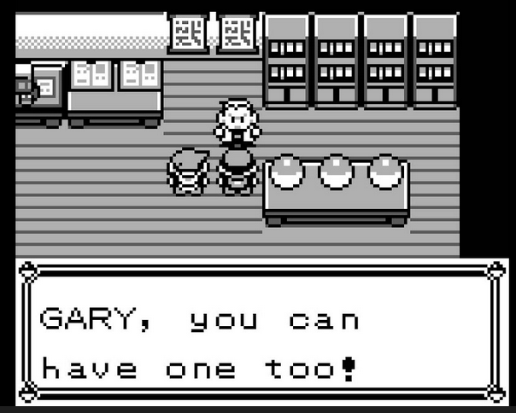
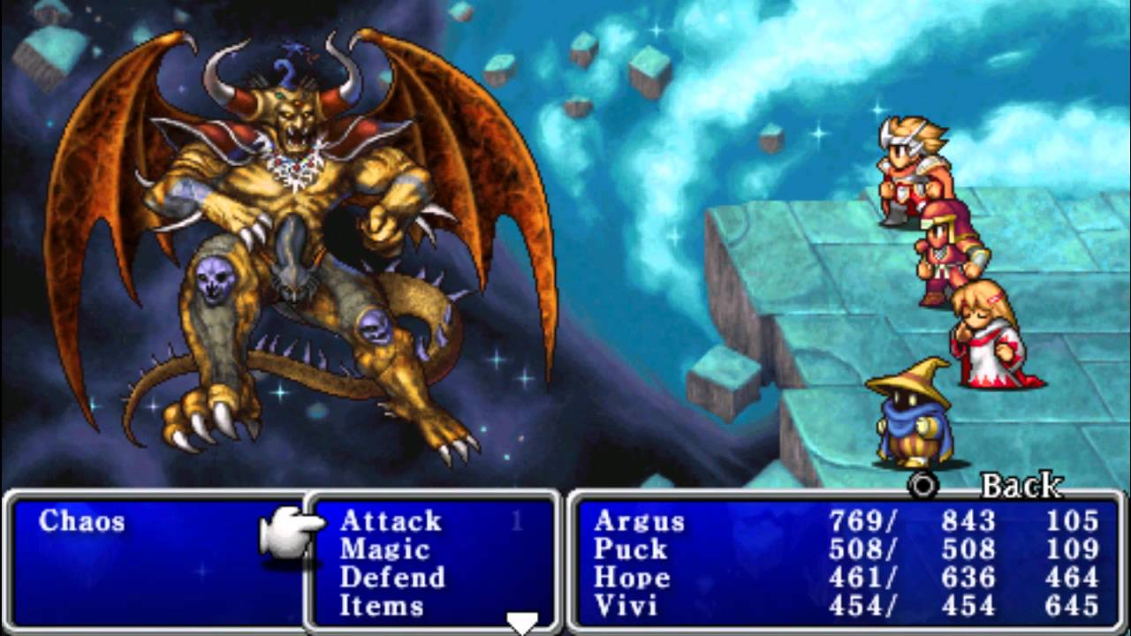
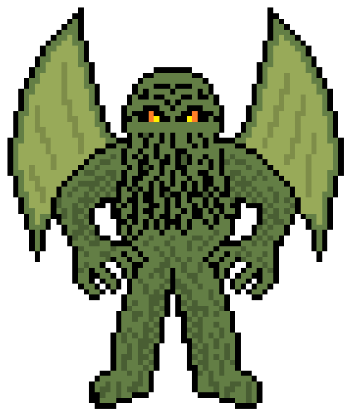
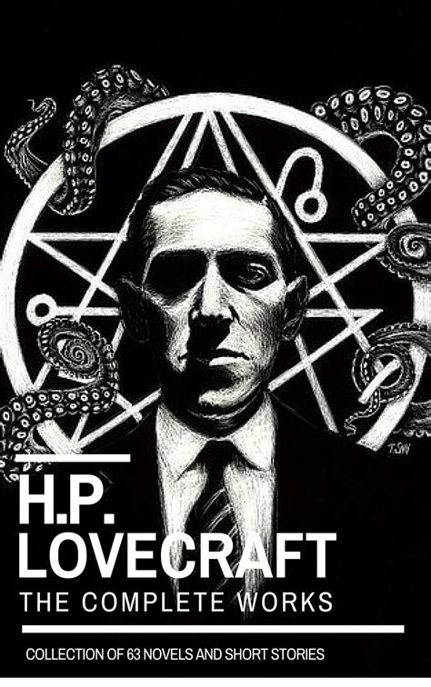
Our Vision
Notes:
What every member of our team has in common, is our love for retro games.
Be it Pokemon on the Gameboy or the Final Fantasy series on the SNES.
We wanted to capture the essence of the games we love and create something
new in the process.
The result is a non-isomorphic 2d-view, like in old school Gameboy games.
With a tile base map and low resolution character models.
As in Pokemon you can catch and collect monsters,
but our monsters are inspired by the world of H.P. Lovecraft.
With this in mind we created our world.

Slide 5
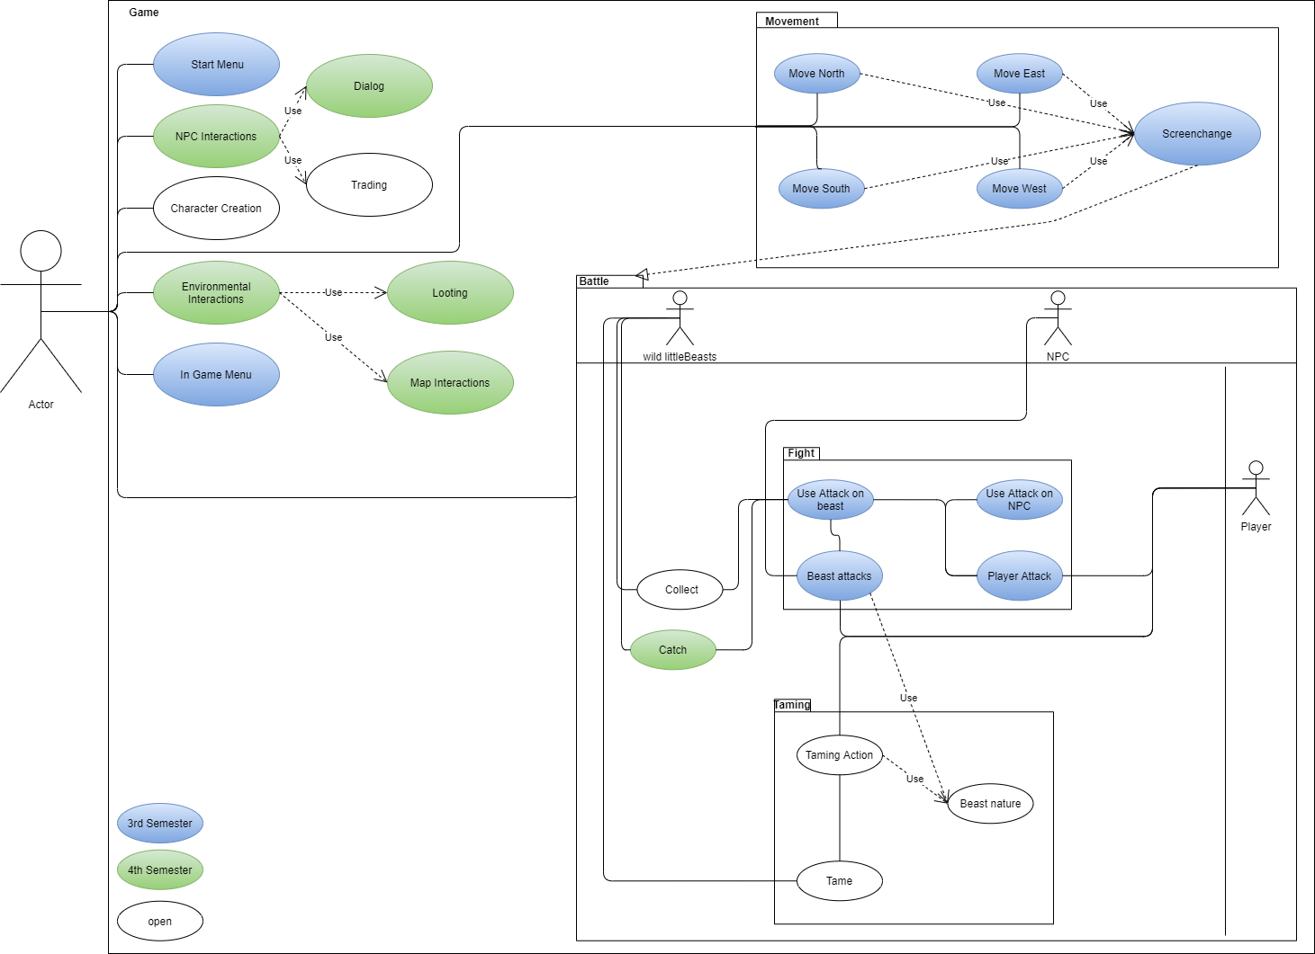
The Scope

Slide 6
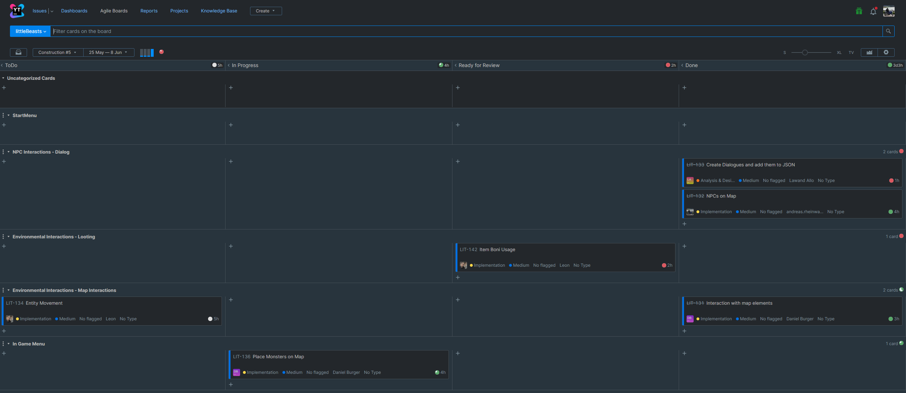
iterative scrumming

Slide 7
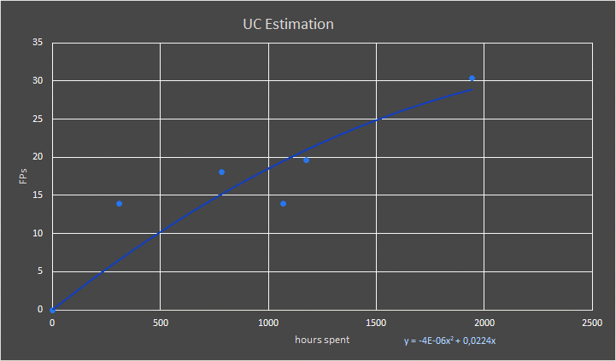
Function points

Slide 8
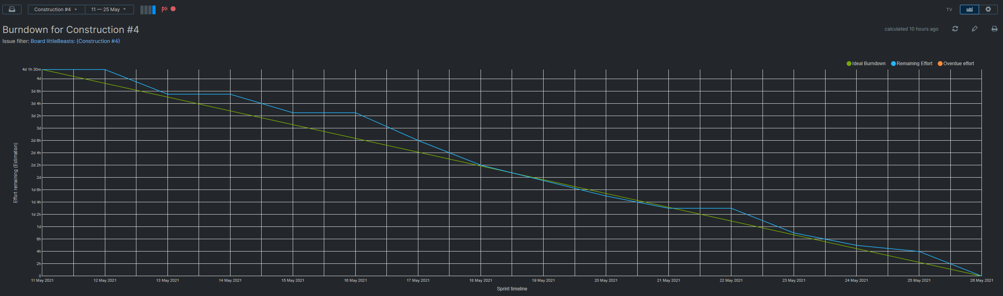
Burn down chart

Slide 9
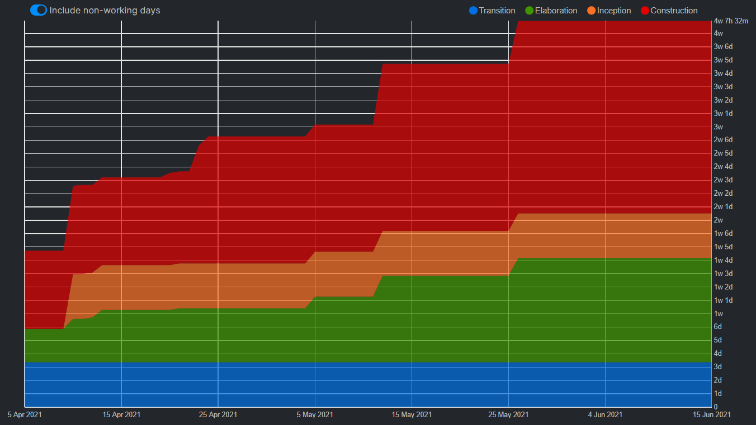
CUMULATIVE flow (RUP phases)

Slide 10
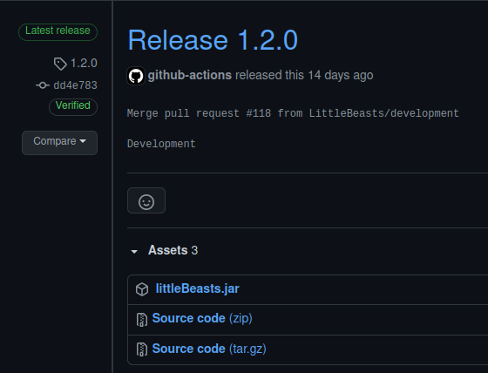
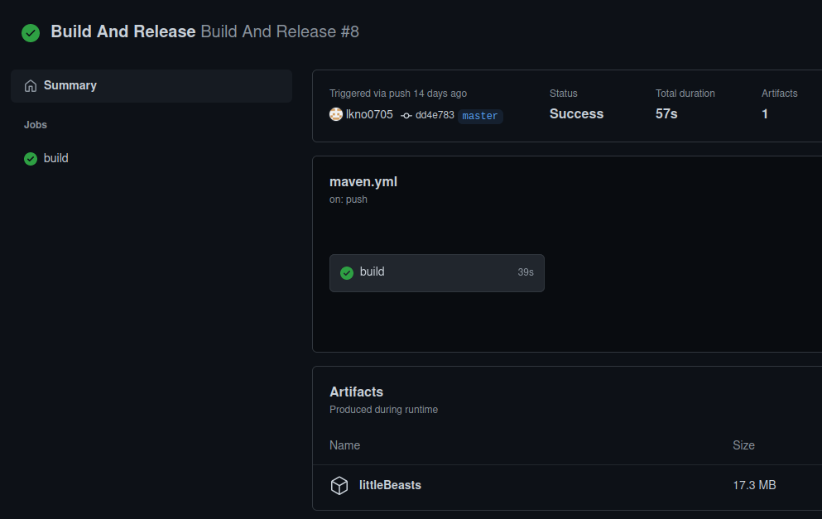
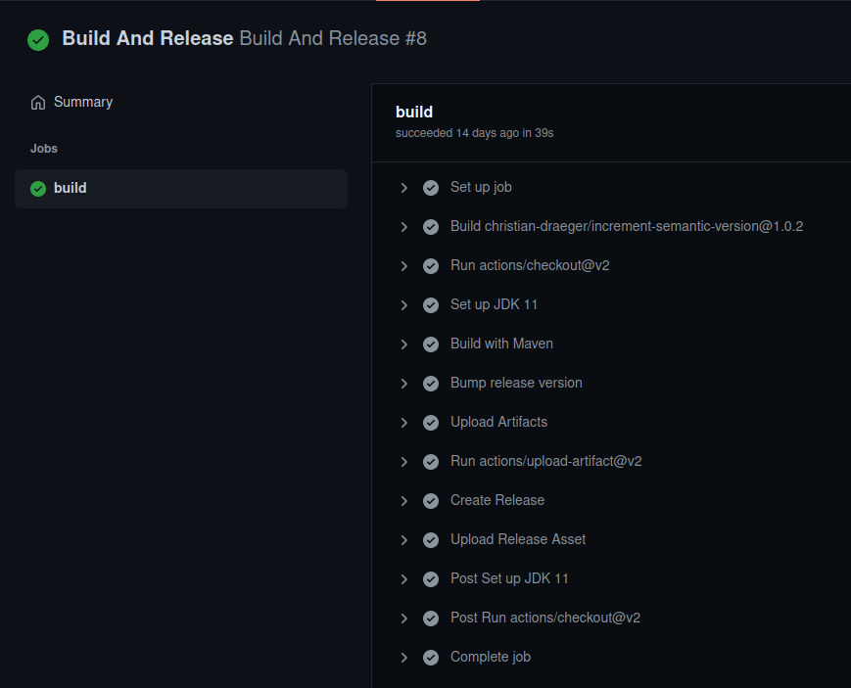
CI/CD

Slide 11
Workflow
YouTrack
Research phases
Refactoring
IntelliJ
Code Review
Tests/Metrics
Refactoring
CI/CD
Github

Slide 12
Technical abilities

Slide 13

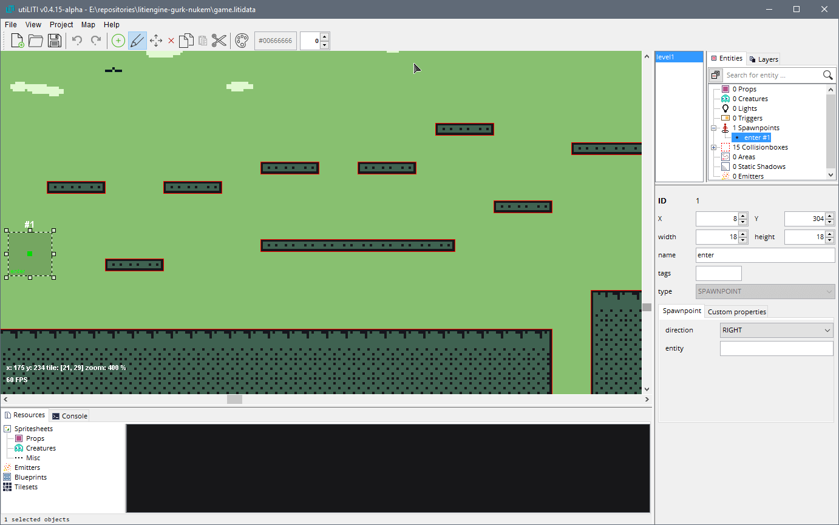


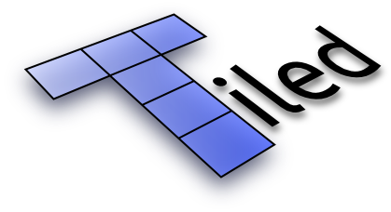







Technologies - LitiEngine
Notes:
Creating a game is an enormous tasks and especially the graphics can be challenging.
So we use LitiEngine in our project. This Engine helps us with recourse management,
For example maps, sprites and sounds.
Also the controller inputs are handled by LitiEngine, this gives us more freedom to
concentrate on the actual game design.
LitiEngine delivers a tool - UtiLiti - to input and manage all resources into a recourse
file which can then be adressed with the Liti Engine in Java.
For the actual map creation we use the "tiled" map editor. This allows us to create
different map layers and works flawlessly in combination with the UtiLiti tool.
As we are no graphic artist we used graphic recourses from the itch.io library.

Slide 14
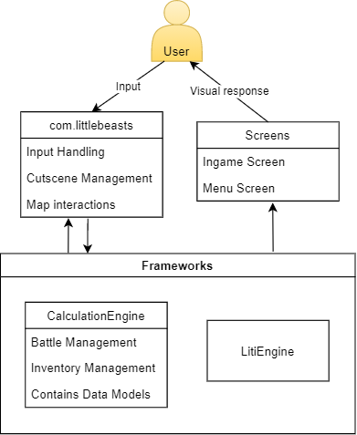
High-Level Architecture

Slide 15
quality assurance

Slide 16

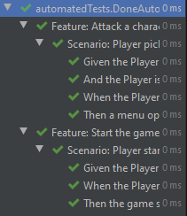
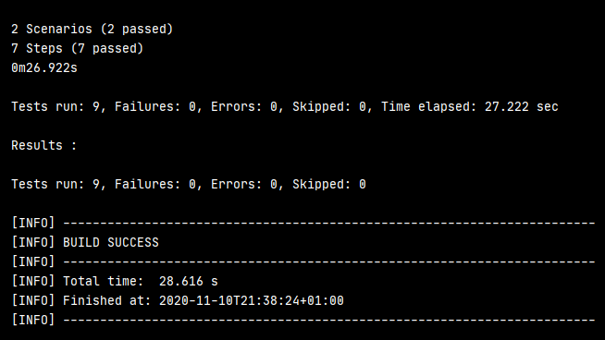
Testing

Slide 17
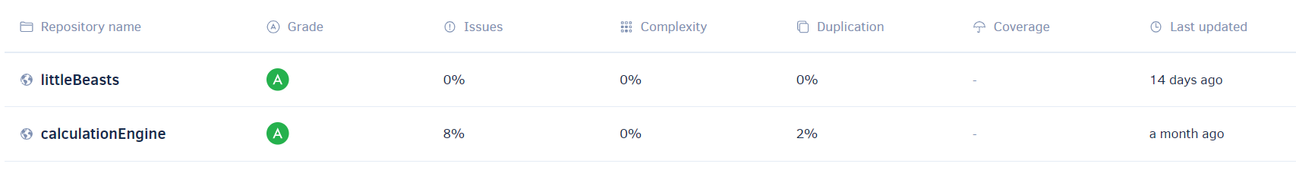
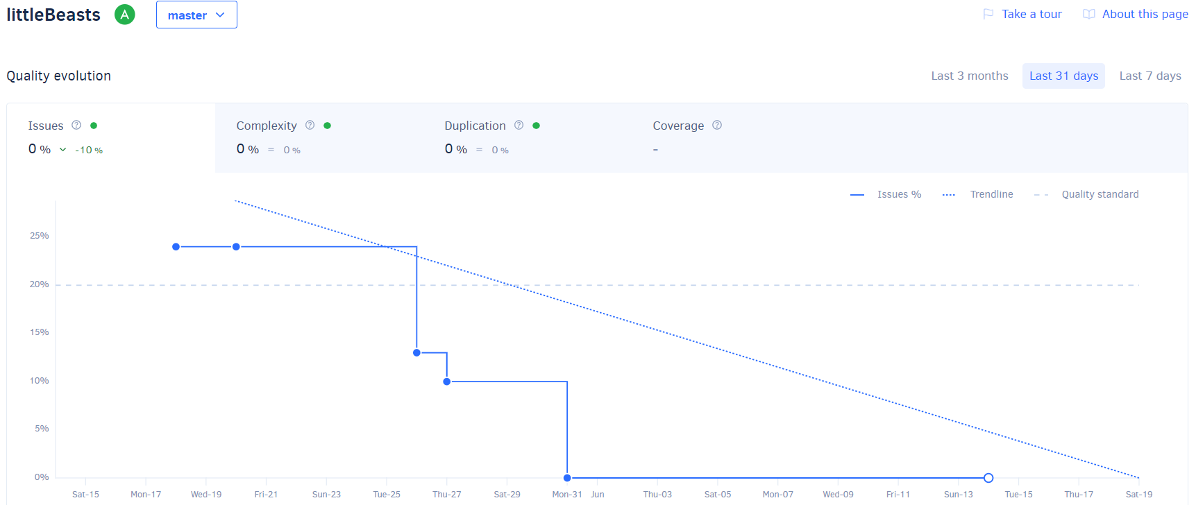
Codacy

Slide 18
DEMO

